Slide 1
NUMBER SIGN RECOGNITION SYstem
-HIMANSHI RAO, IT-4028-2k16
-SUMIT PRASAD, IT-4056-2k16

Slide 2
INTRODUCTION
This project aims at identifying Digits in American Sign Language from the corresponding gestures. Gesture recognition and sign language recognition has been a well researched topic for American Sign Language(ASL). But instead of using high-end technology like gloves, we aim to solve this problem using state of the art computer vision and machine learning algorithm.

Slide 3
MOTIVATION
Communication is one of the basic requirements for survival in society. Deaf and dumb people communicate among themselves using sign language but normal people find it difficult to understand their language.
Our project aims at taking the basic step in bridging the Communication gap between normal people and deaf and dumb people using Indian sign language. Effective extension of this project to alphabets, words and common expressions may not only make the deaf and dumb people communicate faster and easier with outer world, but also provide a boost in developing autonomous systems for understanding and aiding them.

Slide 4
OBJECTIVE
The main objective is to translate sign language to text/speech. The framework provides a helping-hand for speech-impaired to communicate with rest of the world using sign language. This leads to the elimination of the middle person who generally acts as a medium of translation. This would contain a user-friendly environment for the user by providing speech/text output for a sign gesture input.

Slide 5
NEED
The high-end technological gloves are not convenient to use.
The deaf and dumb people will get a far better way to communicate with normal people without any confusion.
The gloves are much costlier to afford and bulky to handle.
No middle person is required to convey the views in case of not using gloves.

Slide 6
Solution
We have solved this problem with the help of Computer Vision. More specifically, we will build a Deep Convolutional Neural Network and that Neural Net will provide a Real Time Translation for the gestures and make the communication easy.
The datasets that we have used are self made.
The project has 10 classes and each class has 250 images.

Slide 7
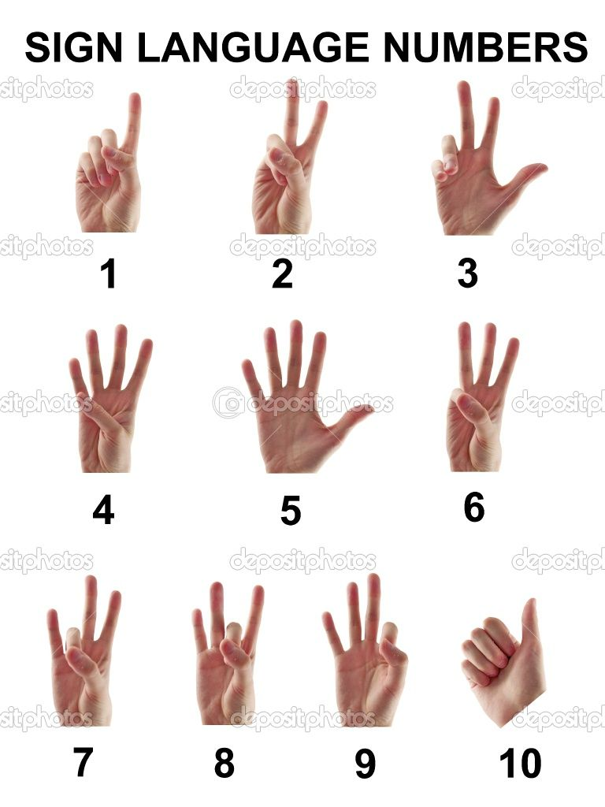
Digit’s Gesture in ASL

Slide 8
Life cycle
This project is divided into 3 modules :
Collect Data Module (Preparing datasets)
Train Model Module (Creating a Neural Network)
Prediction Module (Loading the Neural Net and Predict the Gesture)

Slide 9
Architecture
Pre Processing
Recognition
Capturing Image from the Webcam
Convolutional Neural Network
Feature Extraction
Image Processing
Convolution
OUTPUT
Changing Colour
Applying Non linearity
Thresholding
Max Pooling
Normalization
Extracting Feature Vector
Softmax Function

Slide 10
Image Pre-processing & Processing
The raw image from the video stream is processed to extract and detect edges ,different colour variation on different pixels. The processing means thresholding the image to obtain a definite edge structure. Moreover, the learning algorithm needs consistent dataset and the dataset must be similar in nature. Pre-processing converts the inconsistent data to consistent data.
This processing is done using cv2 (Open CV) library in Python.

Slide 11
Recognition
Once processed the images are feed to convolutional layers where Max Pooling is done to obtain the input for next hidden layers. ReLU function is used for activation. Iterative backpropagation takes place to obtain the error .If error is acceptable then prediction is done by model otherwise it back-propagate.
Backpropagation is implemented implicitly by Keras library in Python.

Slide 12
WHAT WE HAVE DONE SO FAR!

Slide 13
THANK YOU

